Slide 1
Computer Graphic Final Project
PRODUCT MARKETING
WEBSITE
Presentation By
Group 5

Slide 2
GROUP MEMBERS
5025201129
Shafina Chaerunisa
5025201116
Denta Bramasta Hidayat
5025201120
Selomita Zhafiirah
502520117
Muhammad Fatih Akbar

Slide 3
TABLE OF CONTENTS
01
02
03
General Desc.
Implementation
References
What is our thoughts on what is going to be made in the Final Project.
A vision on how this is going to be implemented & practiced.
Link & References to inspirations and other stuff mentioned in this presentation.

Slide 4
01
GENERAL DESCRIPTION

Slide 5
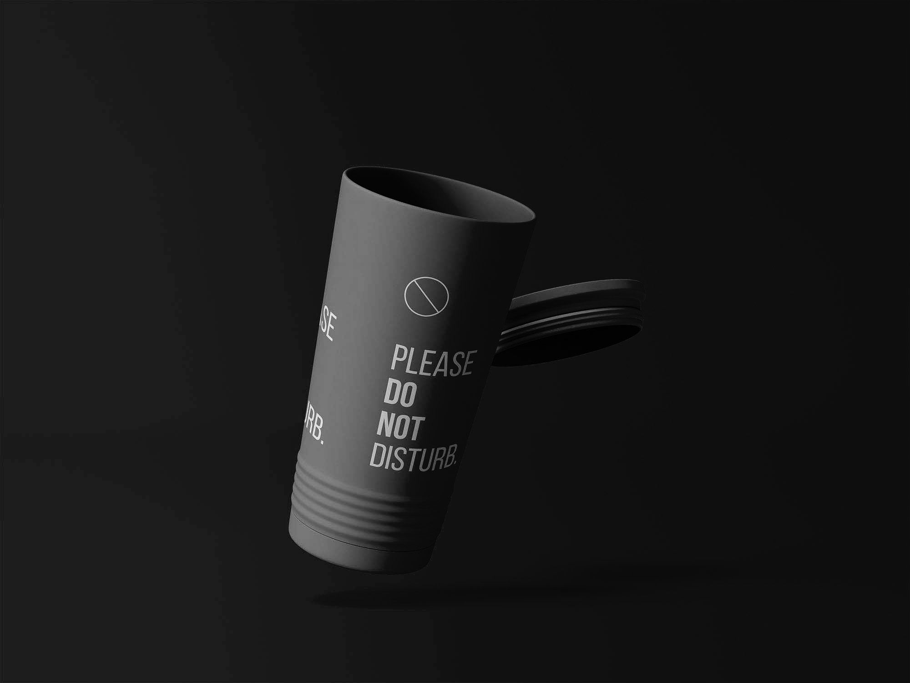
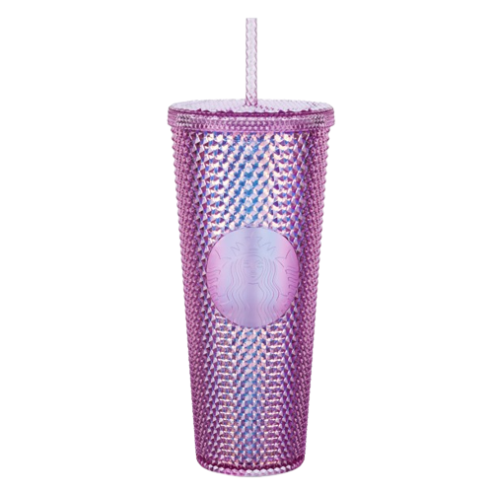
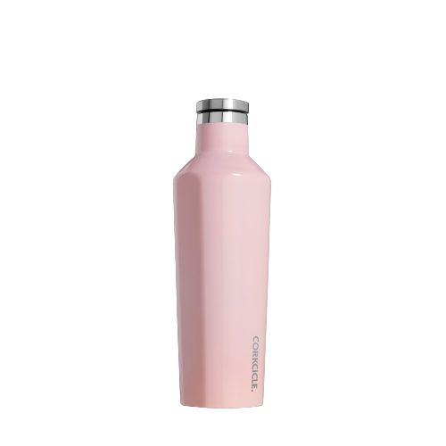
Idea
Through this final project, Jolly Rangers want to make a product marketing / ads website. The product that will be displayed is Tumbler.
The website will display a 3d Model of the Tumbler and show all its features and functionality. Additionally slogans and other marketing words will be shown as well to entice viewer of the website to buy this marketable Tumbler.

Slide 6
02
IMPLEMENTATION

Slide 7
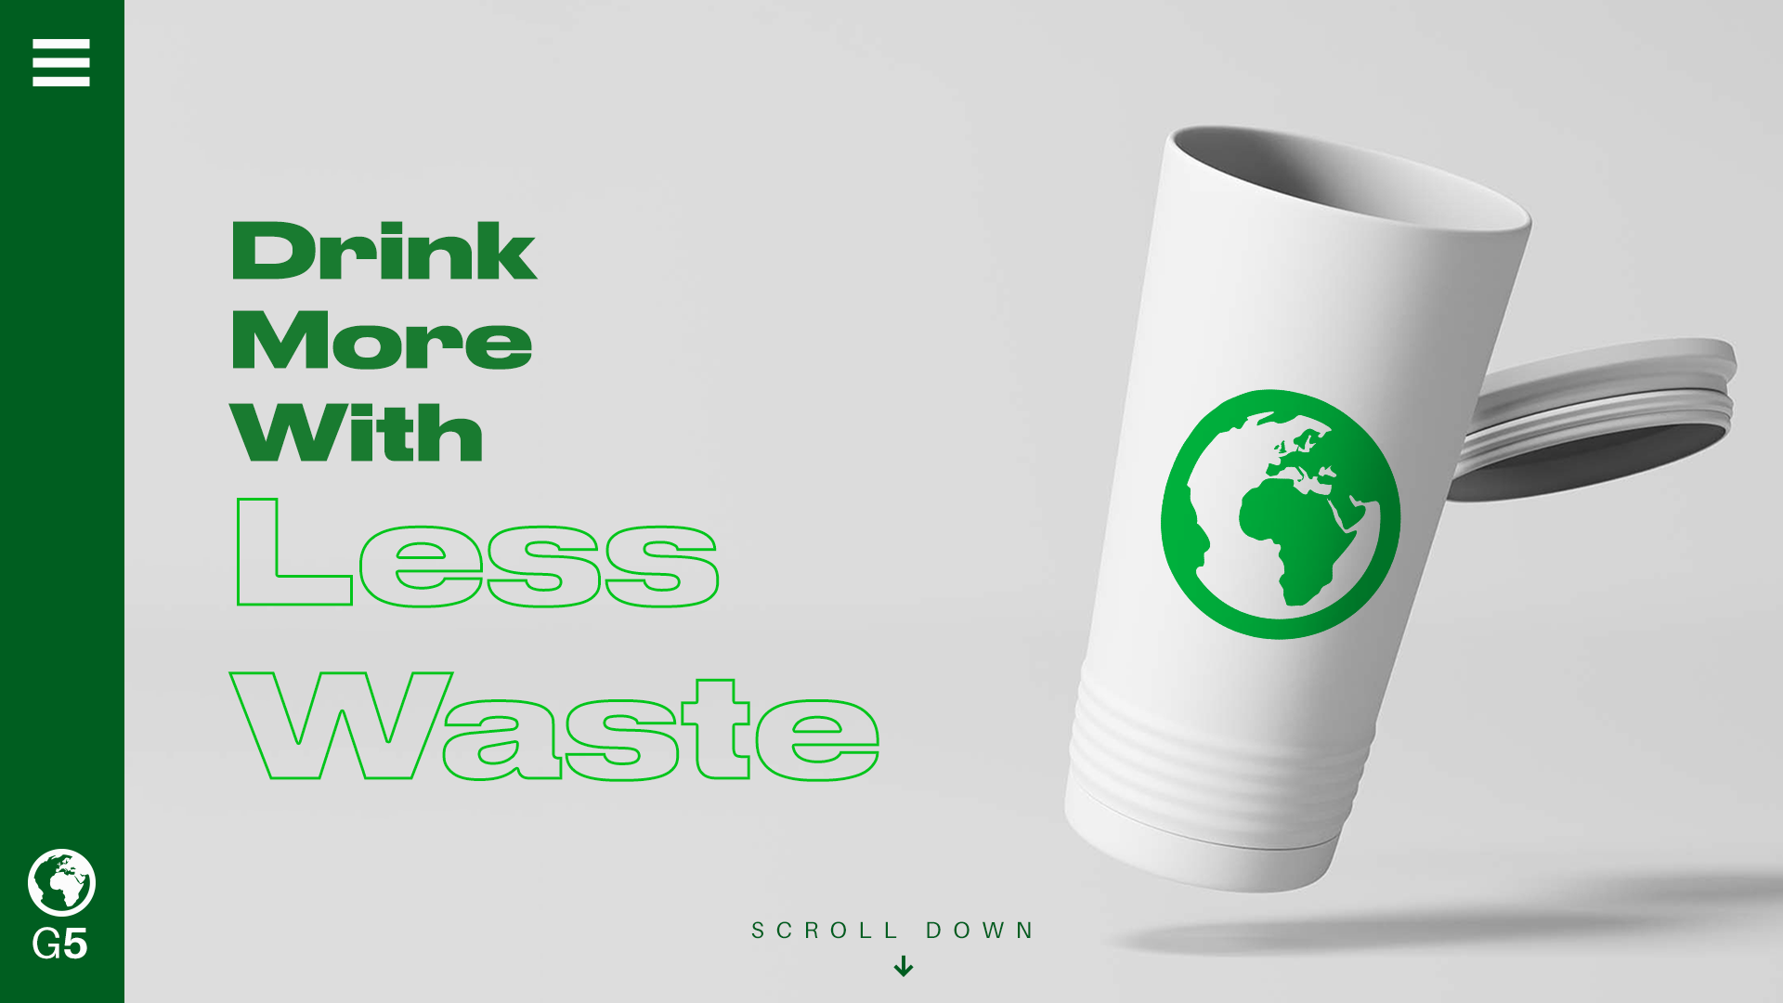
ROUGH SKETCH
MAY DIFFER WITH FINAL PRODUCT

Slide 8
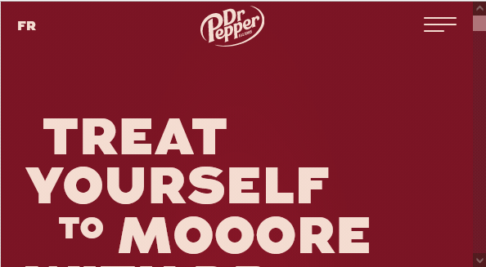
INTERACTIONS
When a user scroll down the camera angle/the tumbler will moves and change poses or into other transitions.

Slide 9
OBJECTS & ELEMENTS
01
02
03
Tumbler
Texts
Images
Earth is the third planet from the Sun and the only one that harbors life in the Solar System. This is where we all live
Jupiter is a gas giant and the biggest planet in the Solar System. It's the fourth-brightest object in the night sky
Despite being red, Mars is actually a cold place. It's full of iron oxide dust, which gives the planet its reddish cast

Slide 10
SOFTWARES
01
Three.JS
02
WebGL
03
04
Text Editors
Browsers

Slide 11
03
REFERENCES

Slide 12
References
Venus has a beautiful name and is the second planet from the Sun. It’s terribly hot, even hotter than Mercury, and its atmosphere is extremely poisonous. It’s the second-brightest natural object in the night sky after the Moon
Earth is the third planet from the Sun and the only one that harbors life in the Solar System. This is where we all live on
Jupiter is a gas giant and the biggest planet in the Solar System. It's the fourth-brightest object in the night sky. It was named after the Roman god of the skies and lightning
Mercury is the smallest planet in the Solar System. It was named after the Roman messenger god
Despite being red, Mars is actually a cold place. It's full of iron oxide dust, which gives the planet its reddish cast

Slide 13
THANKS!
Do you have any questions?
youremail@freepik.com
+34 654 321 432
yourwebsite.com
Please keep this slide for attribution

Slide 14
BACKGROUND
This is a slide structure based on a marketing plan presentation
You can delete this slide when you’re done editing the presentation
Fonts | To view this template correctly in PowerPoint, download and install the fonts we used
Used and alternative resources | An assortment of graphic resources that are suitable for use in this presentation
Thanks slide | You must keep it so that proper credits for our design are given
Colors | All the colors used in this presentation
Icons and infographic resources | These can be used in the template, and their size and color can be edited
Editable presentation theme | You can edit the master slides easily. For more info, click here
For more info: SLIDESGO | SLIDESGO SCHOOL | FAQs
You can visit our sister projects: FREEPIK | FLATICON | STORYSET | WEPIK | VIDEVO

Slide 15
—SOMEONE FAMOUS
“This is a quote, words full of wisdom that someone important said and can make the reader get inspired.”

Slide 16
GOALS
Short term
Long term
Jupiter is a gas giant and the biggest planet in the Solar System. It's the fourth-brightest object in the night sky. It was named after the Roman god of the skies and lightning
Despite being red, Mars is actually a cold place. It's full of iron oxide dust, which gives Mars its reddish cast
Venus has a beautiful name and is the second planet from the Sun. It’s terribly hot, even hotter than Mercury, and its atmosphere is extremely poisonous. It’s the second-brightest natural object in the night sky after the Moon
Mercury is the closest planet to the Sun and the smallest one of them all

Slide 17
OUR EVOLUTION
2XXX
2XXX
2XXX
2XXX
Earth
Jupiter
Mars
Neptune
Earth is the third planet from the Sun and the only one that harbors life in the Solar System. This is where we all live
Jupiter is a gas giant and the biggest planet in the Solar System. It's the fourth-brightest object in the night sky
Despite being red, Mars is actually a cold place. It's full of iron oxide dust, which gives the planet its reddish cast
Neptune is the farthest planet from the Sun. It's also the fourth-largest planet by diameter in the Solar System

Slide 18
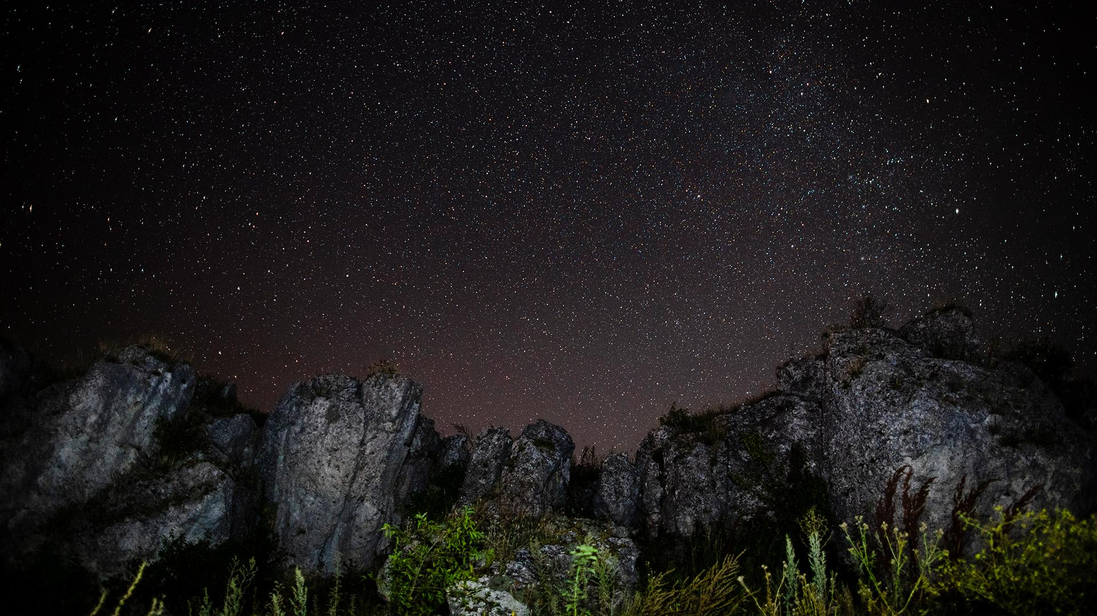
A PICTURE IS WORTH A THOUSAND WORDS

Slide 19
COMPETITOR ANALYSIS
Mercury is the closest planet to the Sun and the smallest one in the entire Solar System. This planet's name has nothing to do with the liquid metal, since Mercury was named after the Roman messenger god. Despite being closer to the Sun than Venus, its temperatures aren't as terribly hot as that planet's. Its surface is quite similar to that of Earth's Moon, which means there are a lot of craters and plains. Speaking of craters, many of them were named after artists or authors who made significant contributions to their respective fields. Mercury takes a little more than 58 days to complete its rotation, so try to imagine how long days must be there! Since the temperatures are so extreme, albeit not as extreme as in Venus, and the solar radiation is so high, Mercury has been deemed to be non-habitable for humans
Mercury is the closest planet to the Sun and the smallest one in the entire Solar System. This planet's name has nothing to do with the liquid metal, since Mercury was named after the Roman messenger god. Despite being closer to the Sun than Venus, its temperatures aren't as terribly hot as that planet's. Its surface is quite similar to that of Earth's Moon, which means there are a lot of craters and plains. Speaking of craters, many of them were named after artists or authors who made significant contributions to their respective fields. Mercury takes a little more than 58 days to complete its rotation, so try to imagine how long days must be there! Since the temperatures are so extreme, albeit not as extreme as in Venus, and the solar radiation is so high, Mercury has been deemed to be non-habitable for humans

Slide 20
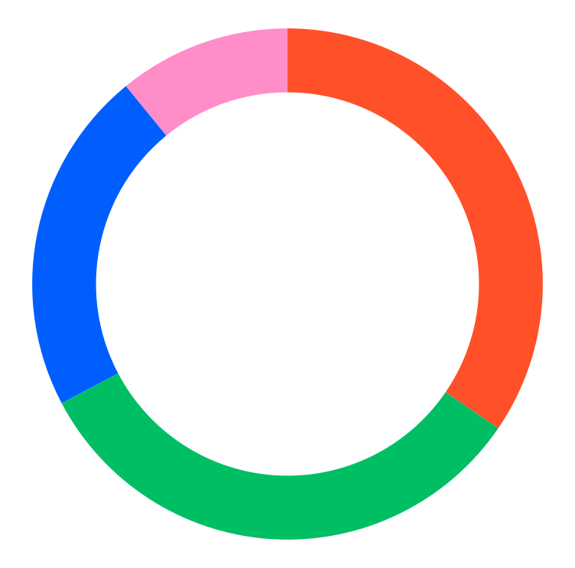
MARKET SHARE
38%
36%
Mercury
Venus
It’s the closest planet to the Sun
Venus is the second planet from the Sun
24%
2%
Mars
Jupiter
Mars is actually a very cold place
Jupiter is the biggest planet of them all
Follow the link in the graph to modify its data and then paste the new one here. For more info, click here

Slide 21
ALTERNATIVE RESOURCES
Here’s an assortment of alternative resources whose style fits the one of this template:
Vectors
Flat sparkling star collection

Slide 22
RESOURCES
Did you like the resources on this template? Get them for free at our other websites:
Photos
Midnight starry night with forest of evergreen trees
Rocky mountains and starry night sky

Slide 23
Instructions for use
If you have a free account, in order to use this template, you must credit Slidesgo by keeping the Thanks slide. Please refer to the next slide to read the instructions for premium users.
As a Free user, you are allowed to:
- Modify this template.
- Use it for both personal and commercial projects.
You are not allowed to:
- Sublicense, sell or rent any of Slidesgo Content (or a modified version of Slidesgo Content).
- Distribute Slidesgo Content unless it has been expressly authorized by Slidesgo.
- Include Slidesgo Content in an online or offline database or file.
- Offer Slidesgo templates (or modified versions of Slidesgo templates) for download.
- Acquire the copyright of Slidesgo Content.
For more information about editing slides, please read our FAQs or visit Slidesgo School:
https://slidesgo.com/faqs and https://slidesgo.com/slidesgo-school

Slide 24
Instructions for use (premium users)
As a Premium user, you can use this template without attributing Slidesgo or keeping the "Thanks" slide.
You are allowed to:
Modify this template.
Use it for both personal and commercial purposes.
Hide or delete the “Thanks” slide and the mention to Slidesgo in the credits.
Share this template in an editable format with people who are not part of your team.
You are not allowed to:
Sublicense, sell or rent this Slidesgo Template (or a modified version of this Slidesgo Template).
Distribute this Slidesgo Template (or a modified version of this Slidesgo Template) or include it in a database or in any other product or service that offers downloadable images, icons or presentations that may be subject to distribution or resale.
Use any of the elements that are part of this Slidesgo Template in an isolated and separated way from this Template.
Register any of the elements that are part of this template as a trademark or logo, or register it as a work in an intellectual property registry or similar.
For more information about editing slides, please read our FAQs or visit Slidesgo School:
https://slidesgo.com/faqs and https://slidesgo.com/slidesgo-school

Slide 25
Fonts & colors used
This presentation has been made using the following fonts:
Righteous
(https://fonts.google.com/specimen/Righteous)
Montserrat
(https://fonts.google.com/specimen/Montserrat)
#f0e8dd
#0f0f0f
#ffffff
#ff5029
#00be64
#005efe
#ff8dc8

Slide 26

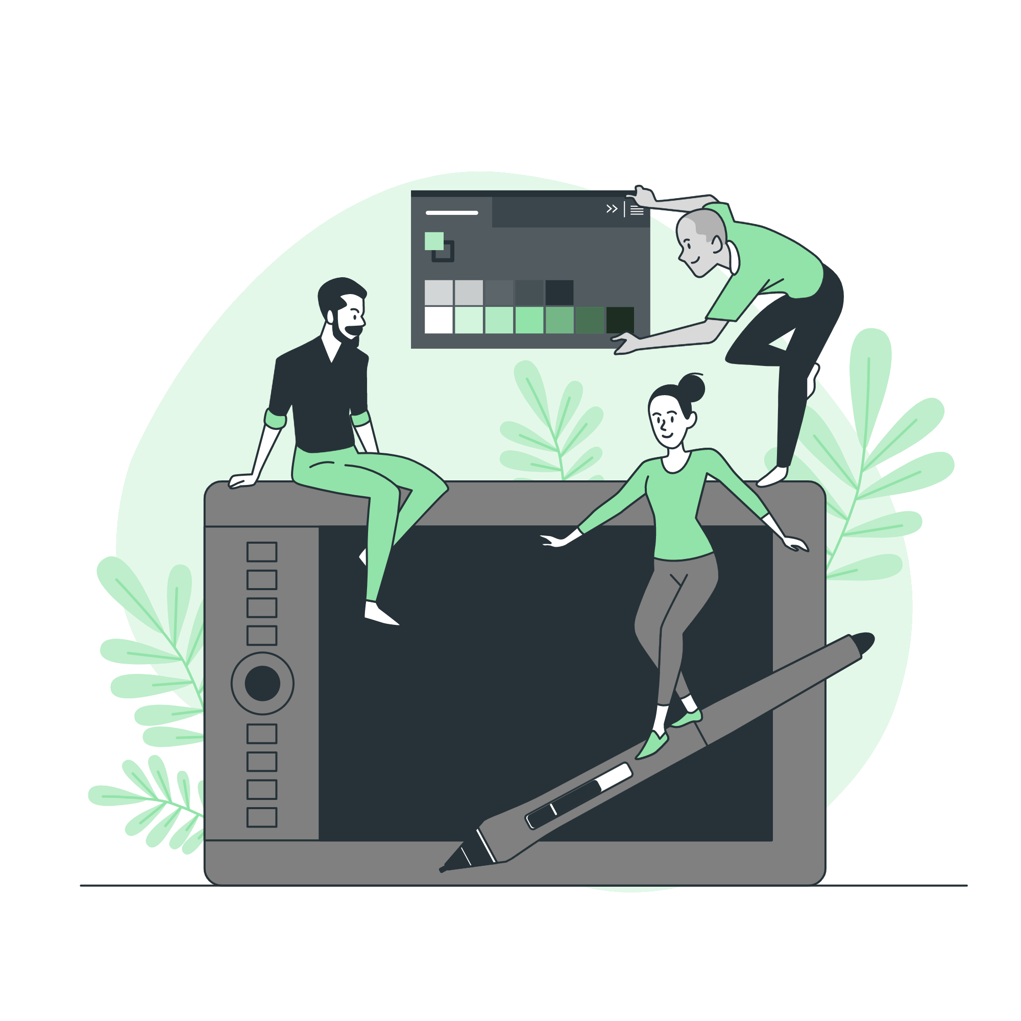

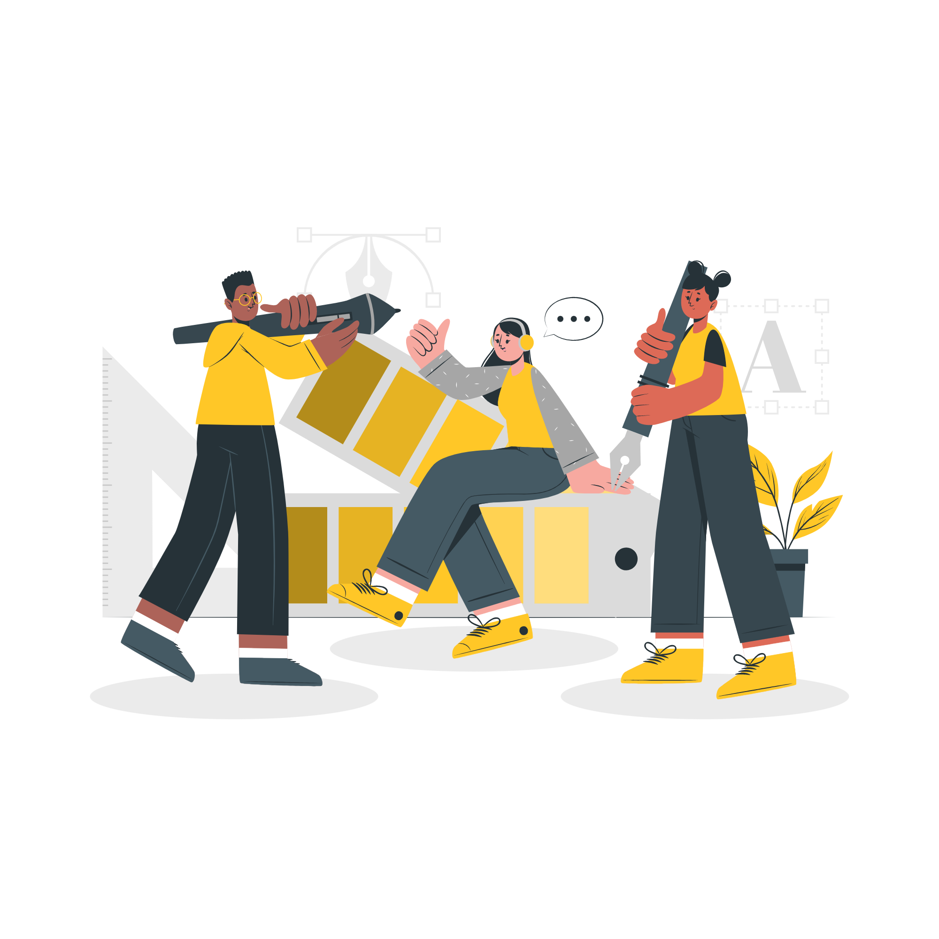

Storyset
Create your Story with our illustrated concepts. Choose the style you like the most, edit its colors, pick the background and layers you want to show and bring them to life with the animator panel! It will boost your presentation. Check out how it works.
Pana
Amico
Bro
Rafiki
Cuate

Slide 27
Use our editable graphic resources...
You can easily resize these resources without losing quality. To change the color, just ungroup the resource and click on the object you want to change. Then, click on the paint bucket and select the color you want. Group the resource again when you’re done. You can also look for more infographics on Slidesgo.

Slide 30
JANUARY
FEBRUARY
MARCH
APRIL
MAY
JUNE
PHASE 1
Task 1
Task 2
PHASE 2
Task 1
Task 2
JANUARY
FEBRUARY
MARCH
APRIL
PHASE 1
Task 1
Task 2

Slide 33
...and our sets of editable icons
You can resize these icons without losing quality.
You can change the stroke and fill color; just select the icon and click on the paint bucket/pen.
In Google Slides, you can also use Flaticon’s extension, allowing you to customize and add even more icons.

Slide 34
Educational Icons
Medical Icons

Slide 35
Business Icons
Teamwork Icons

Slide 36
Help & Support Icons
Avatar Icons

Slide 37
Creative Process Icons
Performing Arts Icons

Slide 38
Nature Icons

Slide 39
SEO & Marketing Icons

Slide 40


